Slide 1

​PIONEERING PUROLATOR CLOUD MIGRATION FOR FINANCIAL EXCELLENCE

Slide 2
Overview
Cloud Migration for Financial Excellence
Why We Choose Public Cloud
Benefits of Public Cloud
Potential Concerns & Solutions
Other Alternatives
Recommendations

Slide 3
Cloud Migration for Financial Excellence
Purolator IT Infrastructure’s Background
Purolator’s Needs

Slide 4
Why Public Cloud?
Cost Reduction
Enhance Operational Efficiency

Slide 5
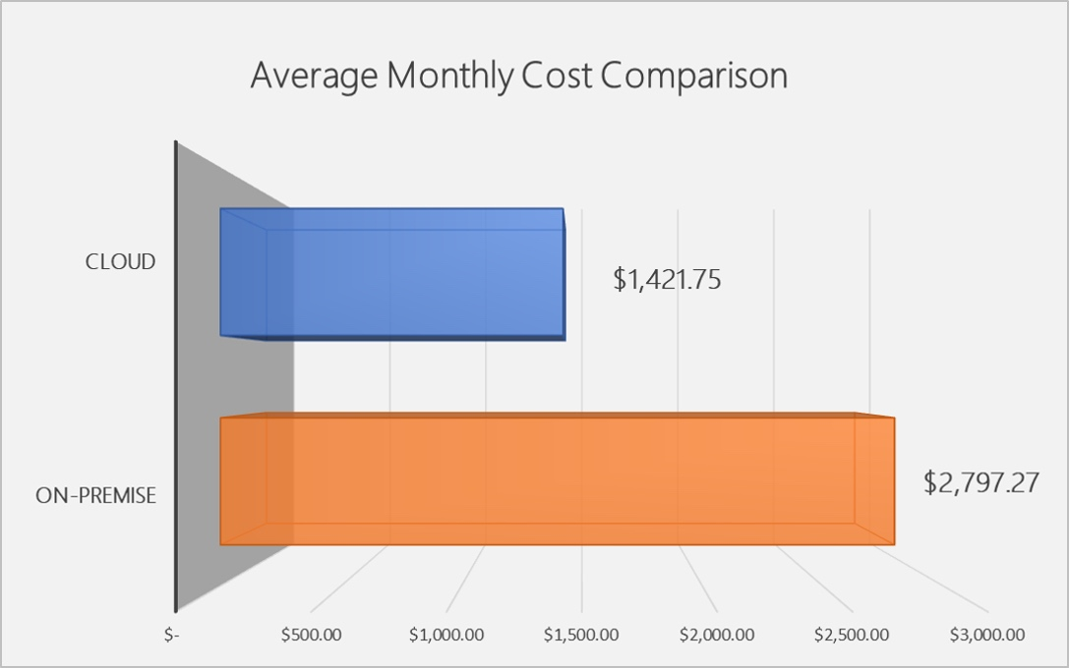
Benefits of Public Cloud
Expense

Slide 6
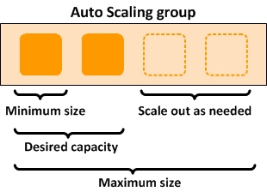
Benefits of Public Cloud (continue)
Scalability

Slide 7

Benefits of Public Cloud (continue)
Accessibility

Slide 8
Potential Concerns & Solutions
Compliance
Data Security
Integration Complexities

Slide 9
Other Alternatives
Hybrid Cloud
Private Cloud

Slide 10
Recommendations
Comprehensive Assessment
Action for Data Security
Gradual Migration
Training and Changing Management

Slide 11
Thank You For Listening

